Slide 1
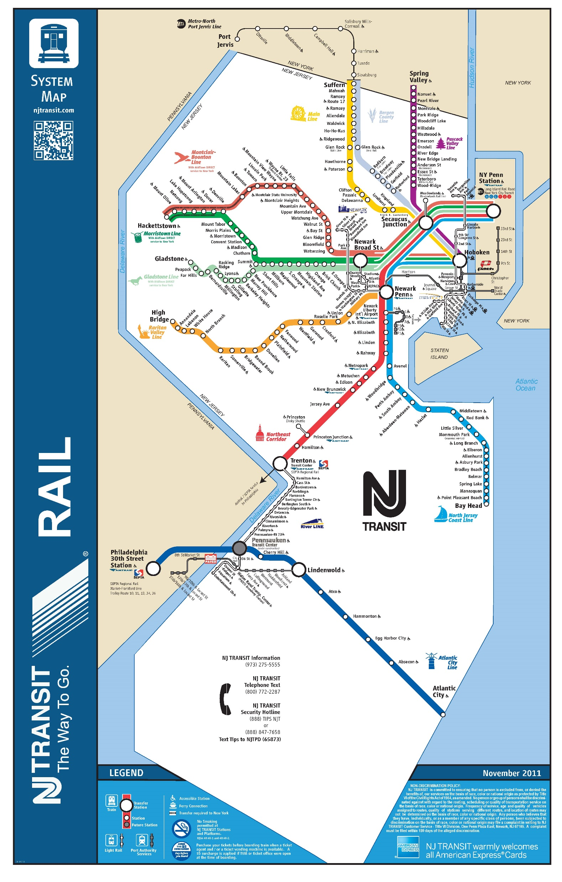
Delay Estimator
A Forecasting Tool for New Jersey Train Delay
Jasmine Siyu Wu and Zoe Yoo

Slide 2
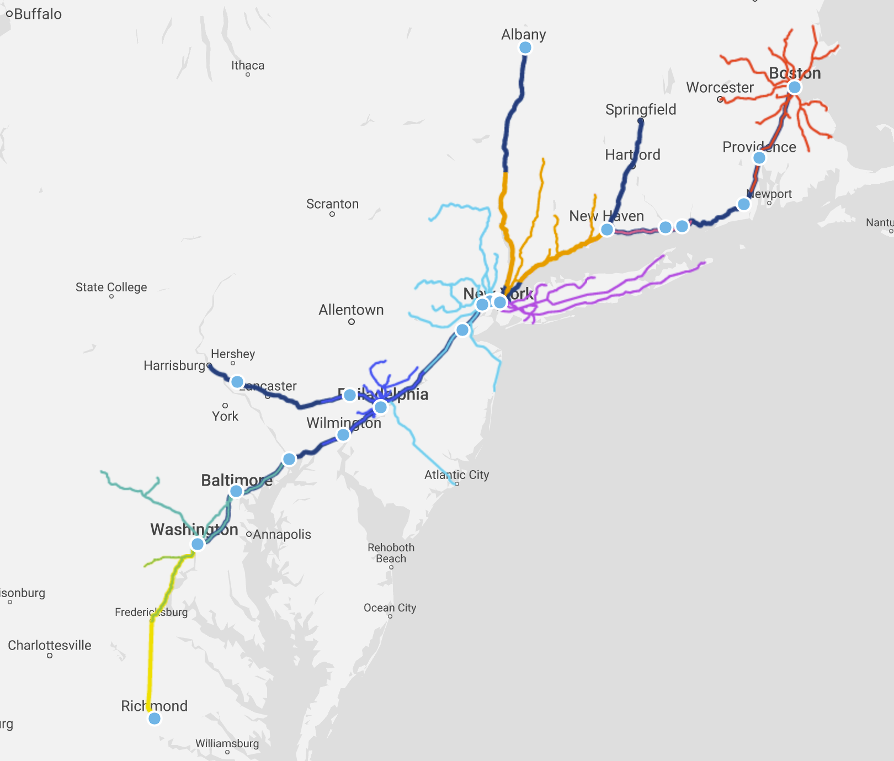
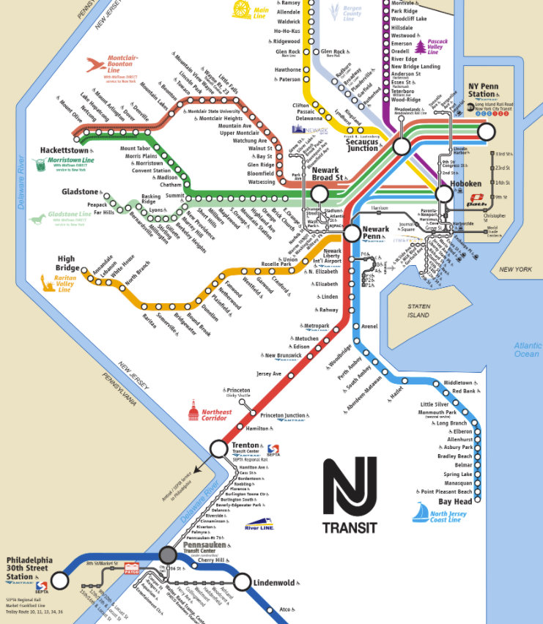

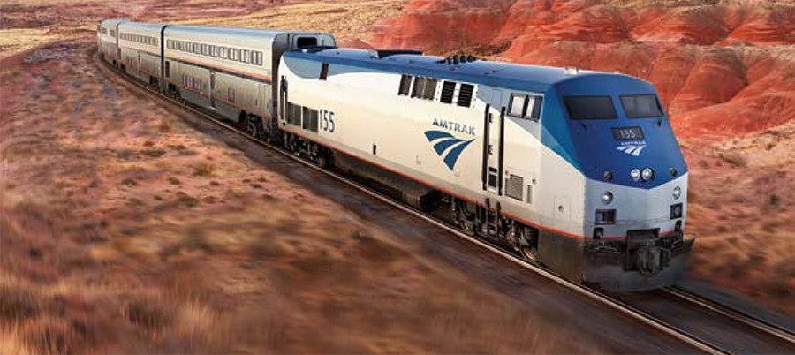
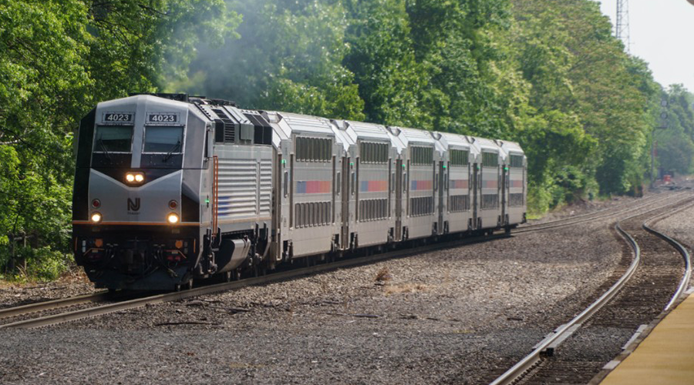
Scope
Initial idea to develop delay estimates for Amtrak and NJ online ticketing
Similar geographies, but data constraints
No scheduling times in Amtrak data
Photo sources: Amtrak, NJ Transit

Slide 3

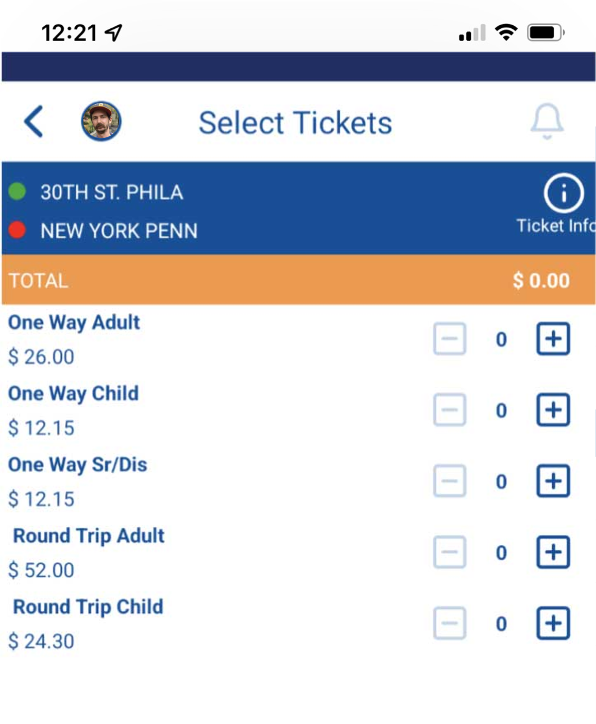
NJ Transit
New Jersey system differs from Amtrak
One-way tickets or passes, with no expiration date
Ticket prices vary based on distance but not time of reservation
Tickets can only be bought on the NJ Transit Mobile App or in-person

Slide 4
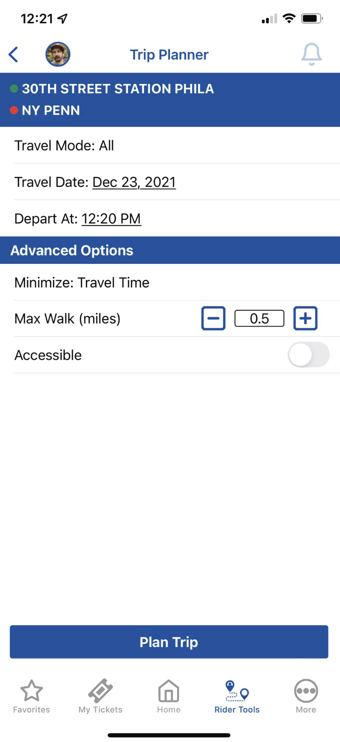
Current Trip Planner
Users pick a specific date and time in the Trip Planner
Minimize travel time, walking distance, etc.

Slide 5
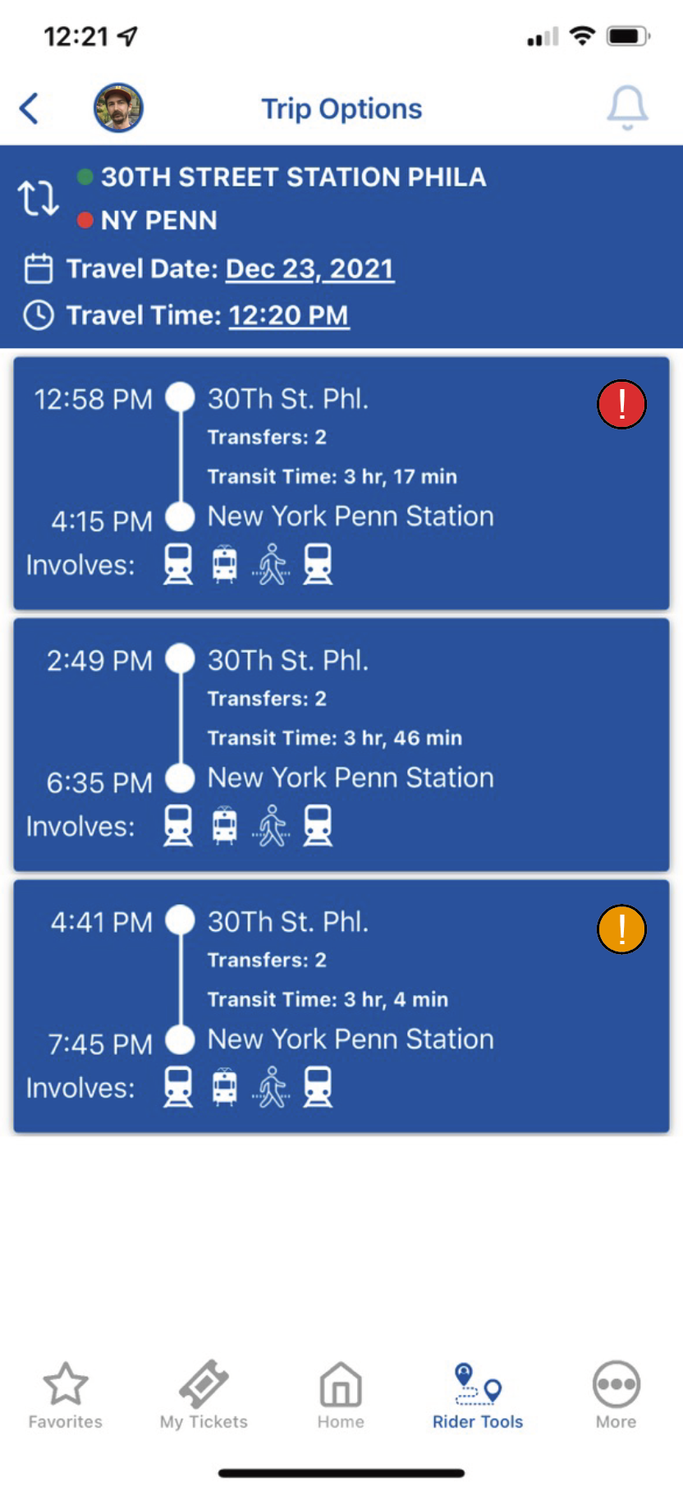



Trip Option Delay
Each time option shows the total predicted delay for that trip
Red = >30 minutes combined predicted delay
Orange = 20-30 minutes combined predicted delay
Yellow = 10-20 minutes combined predicted delay

Slide 6
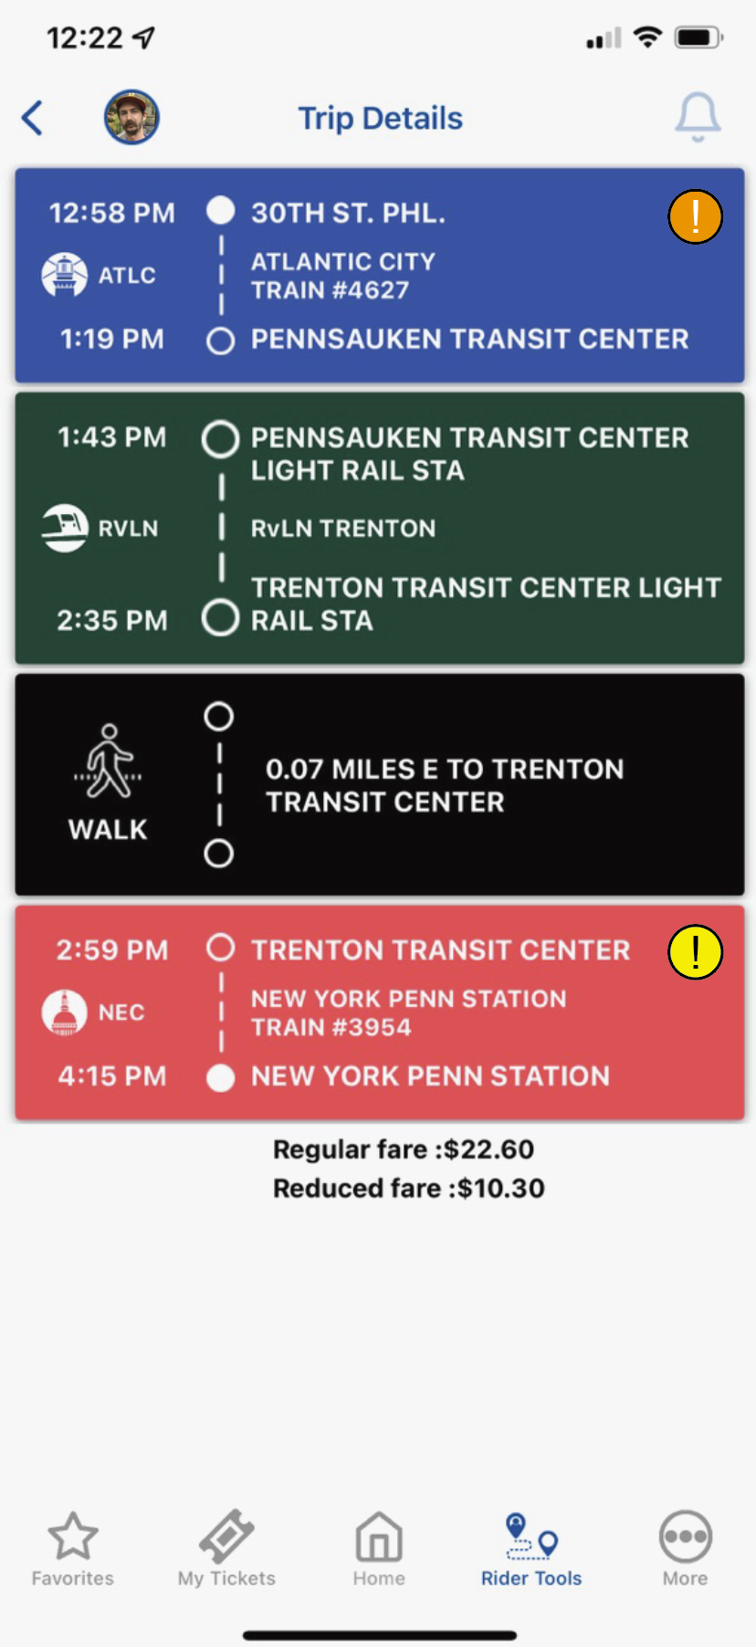
Detailed Trip View
Each leg of trip shows predicted possible delay
Categorized below and summed for the overall trip
Red = >30 minutes predicted delay
Orange = 20-30 minutes predicted delay
Yellow = 10-20 minutes predicted delay

Slide 7
Data Structure
NJ Transit DepartureVision Real Time Train Status Service
Aggregated on Kaggle by Pranav Badami
Sample months: January and February 2021
Basic Data
Train ID
Type (Amtrak or NJT)
Spatial Data
Start Station Name and ID
End Station Name and ID
Stop Sequence Number
Line Name
Temporal Data
Scheduled Time of Departure
Actual Time of Departure
Calculated Delay (minutes)
Date

Slide 8
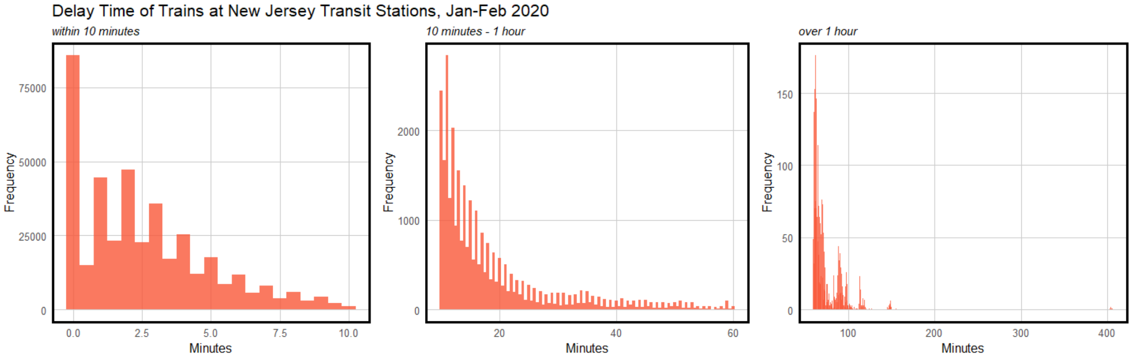
Reviewing the Data
Is delay often / severe enough to warrant a tool for it?

Slide 9
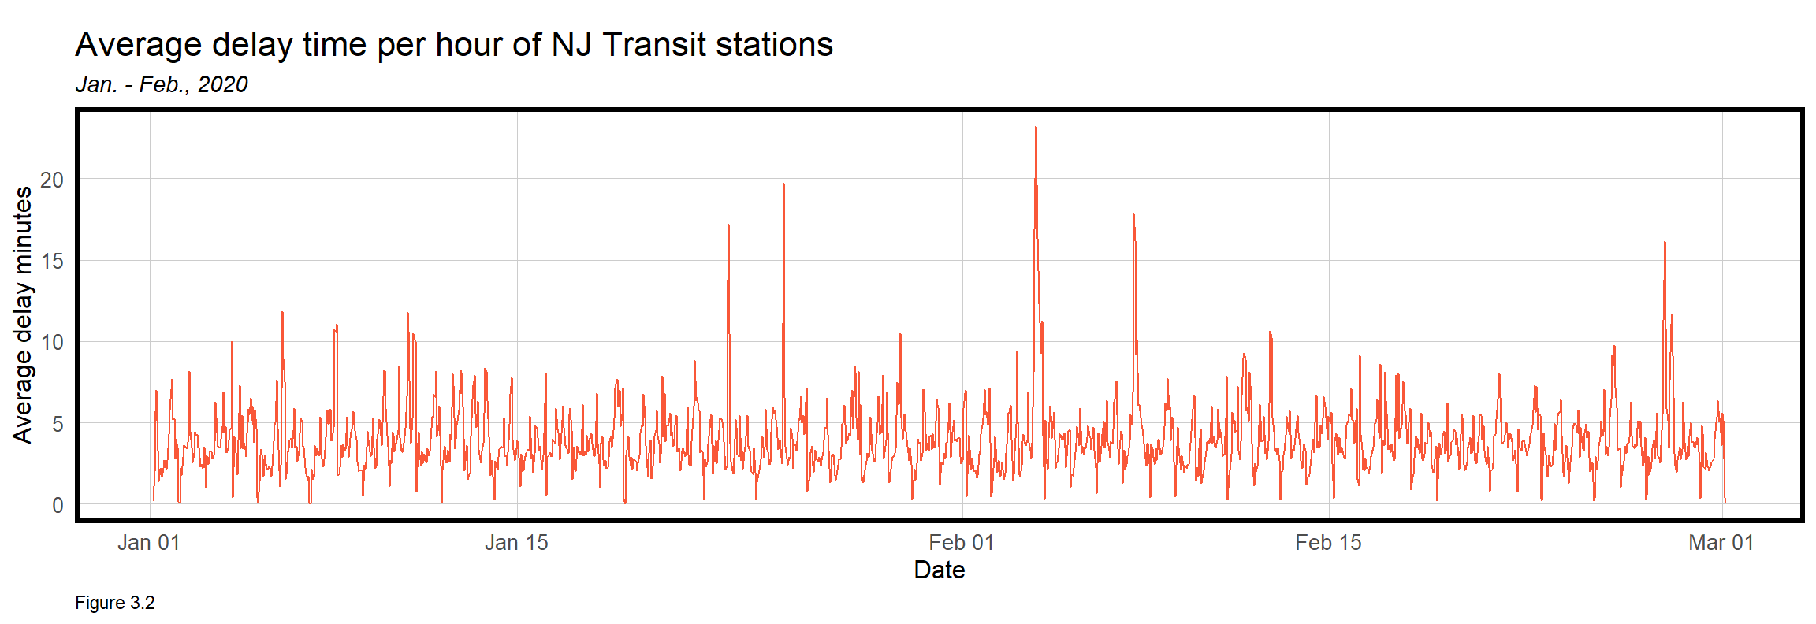
Reviewing the Data

Slide 10
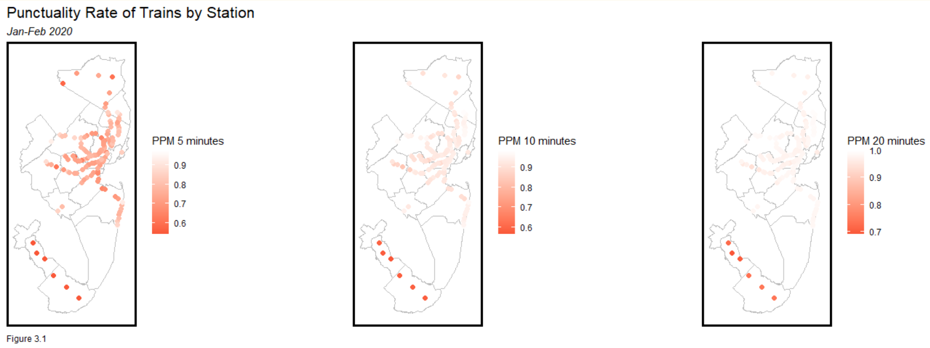
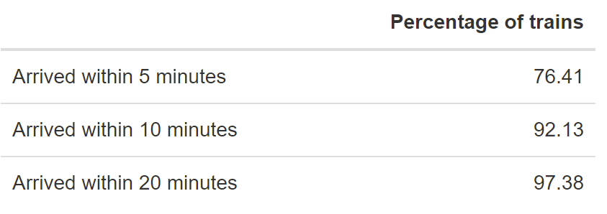
Public Performance Measure (PPM)
Public performance measure (PPM): % of trains arriving at their destination within 5 minutes of schedule
Philadelphia-Atlantic City Line has the lowest PPM
Definition source: Southern Railway, “Train service punctuality and reliability”

Slide 11
On Time
On time: % of trains arriving at the scheduled time at each station stop on a journey
Definition source: Southern Railway, “Train service punctuality and reliability”

Slide 12

Regression Model
Independent Variables

Slide 13
Results

Slide 14
Comparing Accuracy

Slide 15
Further Steps
Increase scope and power of project
Greater computing power
Use a larger sample size of data to ideally gain more accuracy year-round
Comparable/connected systems
Predict on Amtrak if data becomes available
Predict for SEPTA regional rail (connects to NJ Transit)

